Slide 1
RTB - CNS
Apr 2022

Slide 2
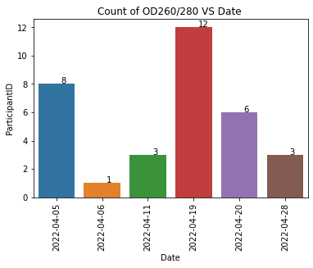
BIO Resource
 | OD 260/280 | OD 260/230 | Concentration
Blood | 1.75 - 2.04 | >1.5 | > 30ng/ul

Slide 3
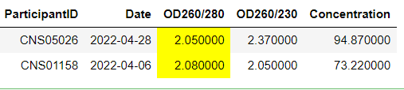
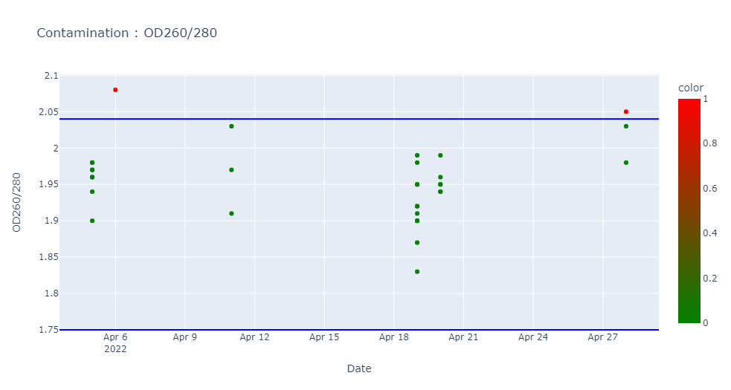
Contamination : OD260/280 (1.75 – 2.04)

Slide 4
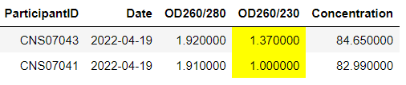
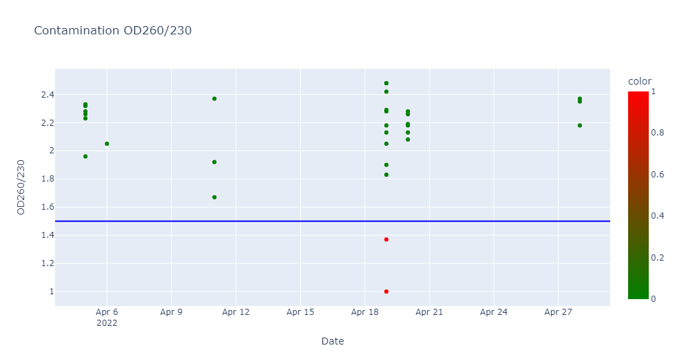
Contamination : OD260/230 (>1.5)

Slide 5
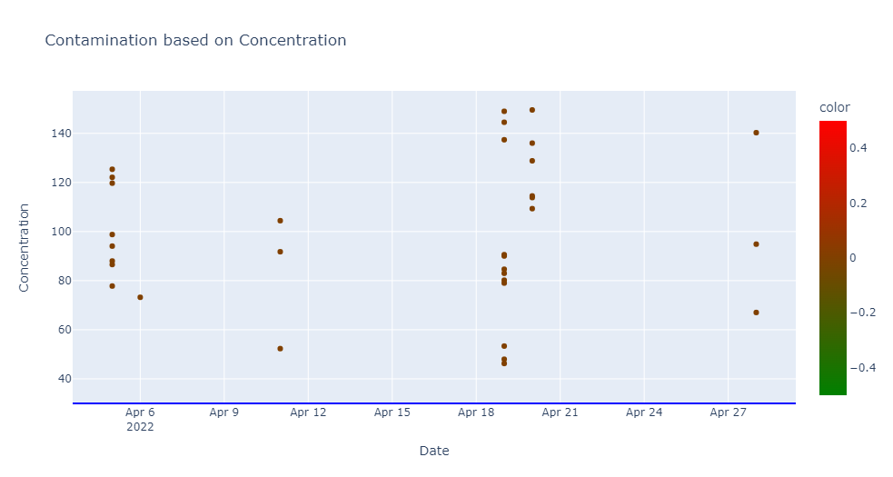
Contamination : Concentration (> 30 ng/ul)
There is NO contamination in the concentration. (ie) All the samples have the concentration of the acceptable range (> 30)

